Slide 1
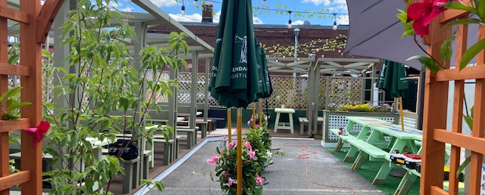
Outdoor Dining
Select board meeting September 14, 2021

Slide 2
Outdoor Dining:
Pre-COVID
Under existing Zoning Bylaw Section 6.9, there are three options:
1. Restaurants whose outdoor seating applications meet these criteria can be approved via an expedited Planning Board process:
    Outdoor seating is limited to April 1 - October 31,
    The seating is not on a designated or required landscaped area, parking lot, or drive aisle, and
    The outdoor area does not increase restaurant seating capacity by more than 30%.
    2. Restaurants proposing seating outside of this criteria must undergo a full Planning Board review.
    3. The Select Board may grant the use of sidewalks for outdoor dining but is prohibited from granting the use of public parking spaces.

Slide 3
Dining during the Pandemic
The State’s COVID-19 pandemic response:
  Governor Baker issued an Executive Order that allowed cities and towns to approve outdoor dining applications without adhering to existing state and local requirements.
  Chapter 20 of the Acts of 2021 extended these flexibilities until April 1, 2022.
  The Town of Needham:
  Established a Downtown Working Group to expedite reviews.
  Created Dine-Around Needham, to encourage local take-out.
  Waived licensing fees and made metered parking free.
  Provided jersey barriers and coordinated with local artists to paint.
  Created parklets and other public seating throughout town.
  Surveyed businesses (restaurants, retail, service) and the public.
  Created 10-min curbside pickup spaces for retail & restaurants.
  Analyzed lessons learned to update policies.

Slide 4
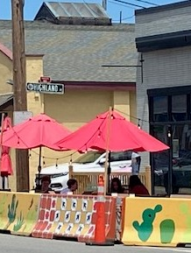
Overview of Existing Outdoor Dining |  | #
Restaurants with outdoor dining today |  | 14
 | With liquor licenses | 11
 | On public property | 7
 | On private property | 7
Public parking spaces used for outdoor dining |  | 17
 | On-street parking spots | 9
 | Public lot parking spots | 8
Notes:
Anticipated Process for Outdoor Dining 2022* #
# that will need to go to Planning Board only 0
# that will need to go to ZBA only 1
# that will need to go to Select Board only 1
# that will need to go to both Planning & Select Boards 10
# going to Select Board for liquor license only 4
# going to Select Board for public ROW license only 2
# going to Select Board for ROW and liquor license 5
*Notes: This is an analysis of those that would be continuing the outdoor dining they have today. Two of the 14 restaurants were approved before COVID-19 and likely need no further approval unless they propose something new. This does not include potential applications from restaurants that do not currently have outdoor dining (including 9 with liquor licenses).

Slide 5
Public Survey
1194 of 1233 (96.8%) online respondents said YES to continuing outdoor dining in Needham beyond 4/1/2022.
Categories of Feedback:
Supportive
Safety
Fairness
Alternative Parking/Parking Awareness Campaign
Encourage Biking and Walking
Make Outdoor Dining Aesthetically Pleasing

Slide 6
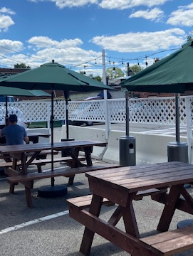
Questions from the Public
Will restaurants be required to pay for use of space?
Will there be outdoor dining seasons or year-round?
Will the number of spaces a restaurant can use be limited to ensure fairness?
Will the Town provide assistance to help restaurants ensure safety or make the spaces aesthetically pleasing?
What criteria will determine whether a restaurant is approved?
Who will ensure the safety of diners in parking spaces?
Will parking meter prices be affected?

Slide 7
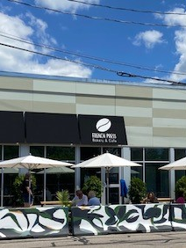
The Future of Outdoor Dining
Update Zoning Bylaw 6.9
    The Planning Board has proposed an amendment to Zoning Bylaw Section 6.9 to be placed on the warrant for the October 2021 Town Meeting.
    This amendment would give the Select Board discretion to approve the use of public parking spaces for outdoor dining and to allow outdoor dining on public property before April 1 or after October 31.
Adopt Select Board Policy
This proposal outlines what is required of applicants and how the Select Board will review and approve outdoor dining on public property.

Slide 8
Timeline
September 8, 2021
Planning Board voted final zoning amendment language for October Special Town Meeting warrant article.
September 14, 2021
September 28, 2021
Select Board reviews initial Outdoor Dining Policy draft detailing how to implement the proposed zoning change.
Public comment period opens.
Public comment period closes.
October 25, 2021
Town Meeting to vote on proposed zoning amendment.
Select Board discusses feedback and possible changes. Potential Board vote on final Outdoor Dining Policy.
April 1, 2022
Outdoor dining season begins.
Accept and process applications.
Fall/Winter ‘21 – ‘22

Slide 9
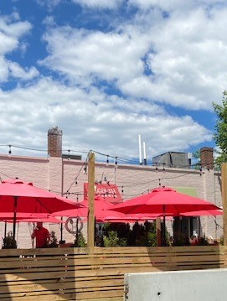
Select Board Draft Policy
PURPOSE
Establish a Select Board process and application criteria for licensing local businesses to use public rights-of-way, public parking lots, on-street parking spaces, sidewalks and/or other Town-owned property for outdoor dining.
GOALS
  Create quality public spaces that contribute to people's health, happiness, and sense of connection to Needham and with each other.
  Support small businesses through added vibrancy and engagement in our business districts.
  Maintain safe and accessible sidewalk access for all users.
  Balance the needs of other street activities, including adequate parking infrastructure.

Slide 10
Select Board Draft Policy
Key Components
Criteria: The Select Board must ensure pedestrian and vehicular circulation, the safety of restaurant patrons and the public, and parking for patrons of the restaurant and for nearby retail and service establishments are adequately provided for before approving an application.
Seasonality: April 1 – October 31. The Select Board has discretion to extend or shorten based on Town needs (construction, snow removal, etc.).
Caps: 3 public parking spaces max per restaurant, including area used by concrete safety barriers.
Fees: $25 annual application fee (waived if also renewing Common Victualler license) plus an annual licensing fee of $100 for sidewalk use and $250 per public parking space.
1 of 2

Slide 11
Select Board Draft Policy
Key Components
Accessibility: Restaurants must maintain 48” of unobstructed paths for sidewalk users; seating must be available to patrons with disabilities.
Safety: Seating cannot impact the visibility at intersections or impede Police/Fire access. Applicants must meet all Health and Building codes. Jersey barriers are required around any seating on-street or in a parking lot. Permits required for outdoor heaters, tents, electrical work, etc.
Community Input: The Select Board will hold a public hearing and will notify abutting property owners within 300 feet at least 7 days in advance. The Town Manager has discretion to waive the hearing for renewals.
2 of 2

Slide 12
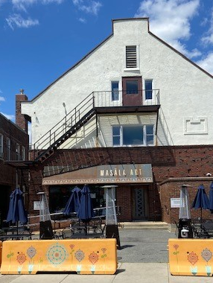
Application Process
Submit an outdoor dining application. Ensure plans comply with Select Board Outdoor Dining Policy and Appendix A: Outdoor Dining Requirements.
Pay $25 application fee. Provide Certificate of Liability insurance.
Town staff will review each application and determine the approvals that are required. If the proposal increases seating capacity by more than 30% or utilizes parking spaces, it must receive approval by the Special Permit Granting Authority that originally approved the restaurant (the Planning Board or the ZBA), before the Select Board will review the application.
If the applicant has a liquor license, file an Alcoholic Beverages Control Commission’s Alteration of Premises form with the Select Board.
Attend Select Board hearing.
If approved, sign license agreement with the Town of Needham for the use of the public right of way. Pay licensing fee of $100 for sidewalks, $250 per parking spot.
Coordinate with the Town for the placement of concrete jersey barriers before outdoor furniture can be installed.
Secure permits needed for tents, outdoor lighting, and heaters.
Notes:
The Select Board determines the use of public rights or way and certain Town-owned properties, including sidewalks, on-street parking spaces, and public parking lots. The Select Board is also the local licensing authority for all alcohol licenses and issues common victualler licenses, which allow restaurants to operate.
The Planning Board and the Zoning Board of Appeals determine the allowable uses of land including outdoor seating on private property. When issuing permits to allow businesses to operate, the Planning Board and the ZBA may also set parking requirements and seating capacities, among other conditions.
The specific details of each outdoor dining proposal will determine if the applicant must go before the Planning Board/ZBA, the Select Board, or both. Town staff will advise applicants on what approvals are required, specific to their application.
The Outdoor Dining season runs from April 1 to October 31. Applicants are strongly encouraged to apply in late fall/early winter prior to the next outdoor dining season. Applicants may need approval from multiple local boards including the Select Board, Planning Board, and/or Zoning Board of Appeals depending on the specifics of the application. Applicants with liquor licenses will also require approval from the Alcoholic Beverages Control Commission, after local approval is received. While the Town will work diligently to process applications, applicants may not receive a decision before April 1.

Slide 13
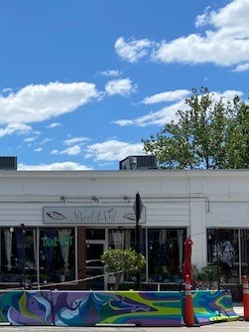
Next Steps
Comments or Questions?
  E-mail: Selectboard@needhamma.gov
  Write to: Needham Town Hall, Office of the Town Manager
  1471 Highland Avenue
  Needham, MA 02492
  Call: 781-455-7500
  The public comment period will end on September 28 at 12 pm.

